Slide 1
Computer Vision
Fall 2018
Problem Set #5
James Peruggia
jperuggia@gatech.edu
Computer Vision @ GT

Slide 2
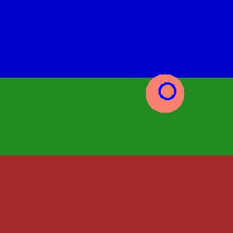
1b: KF Tracking a circle
ps5-1-b-1.png
Computer Vision @ GT

Slide 3

1b: KF Tracking a circle (cont.)
ps5-1-b-2.png
Computer Vision @ GT

Slide 4
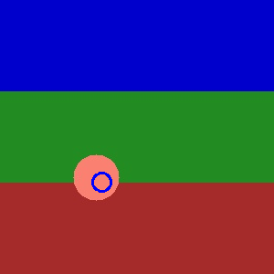
1b: KF Tracking a circle (cont.)
ps5-1-b-3.png
Computer Vision @ GT

Slide 5
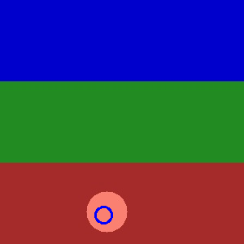
1b: KF Tracking a circle (cont.)
ps5-1-b-4.png
Computer Vision @ GT

Slide 6
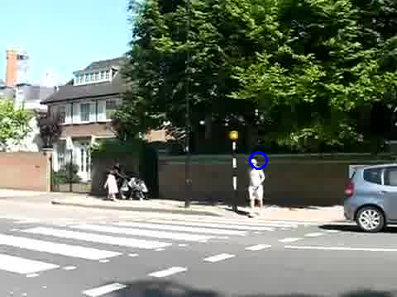
1c: KF Tracking pedestrians
ps5-1-c-1.png
Computer Vision @ GT

Slide 7
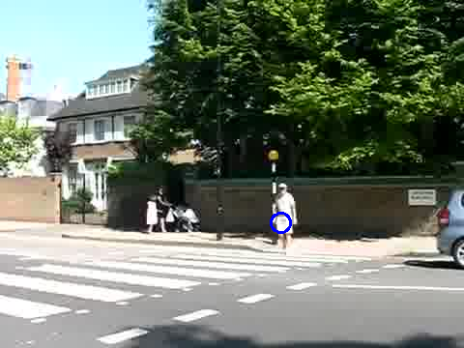
1c: KF Tracking pedestrians
ps5-1-c-2.png
Computer Vision @ GT

Slide 8
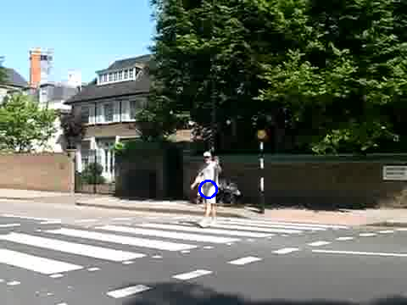
1c: KF Tracking pedestrians
ps5-1-c-3.png
Computer Vision @ GT

Slide 9
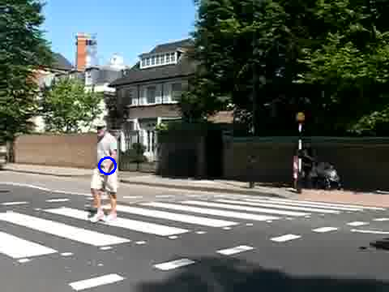
1c: KF Tracking pedestrians
ps5-1-c-4.png
Computer Vision @ GT

Slide 10
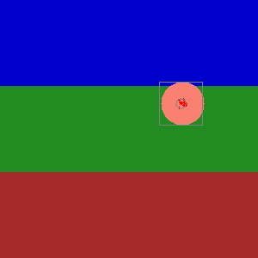
2a: PF Tracking a circle
ps5-2-a-1.png
Computer Vision @ GT

Slide 11
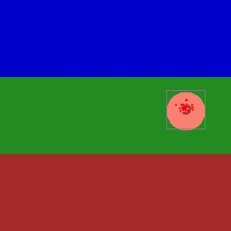
2a: PF Tracking a circle (cont.)
ps5-2-a-2.png
Computer Vision @ GT

Slide 12
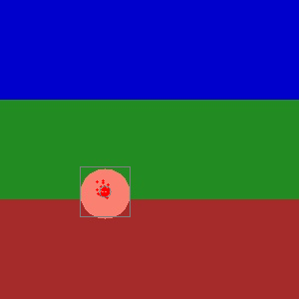
2a: PF Tracking a circle (cont.)
ps5-2-a-3.png
Computer Vision @ GT

Slide 13
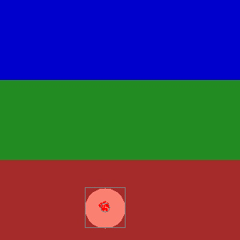
2a: PF Tracking a circle (cont.)
ps5-2-a-4.png
Computer Vision @ GT

Slide 14
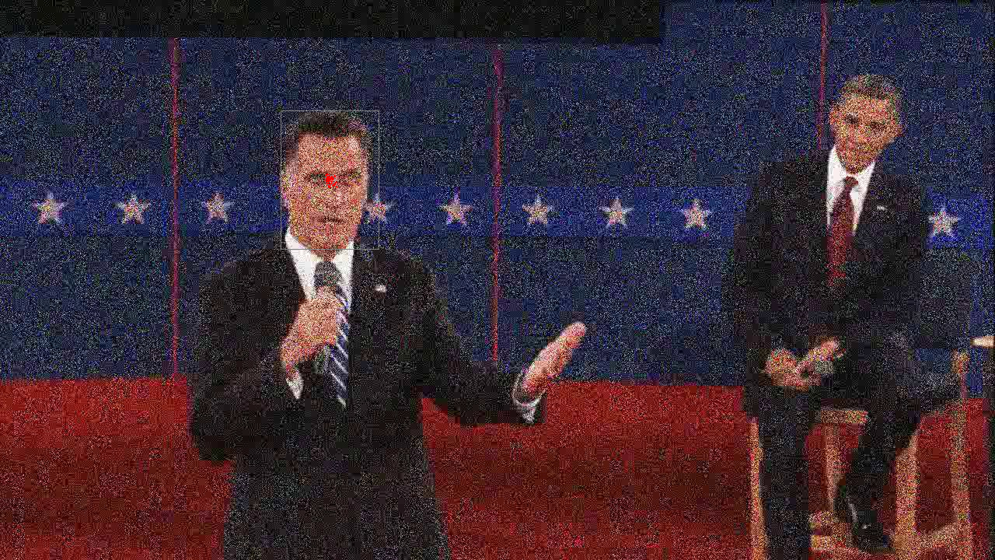
2b: PF Tracking noisy video
ps5-2-b-1.png
Computer Vision @ GT

Slide 15
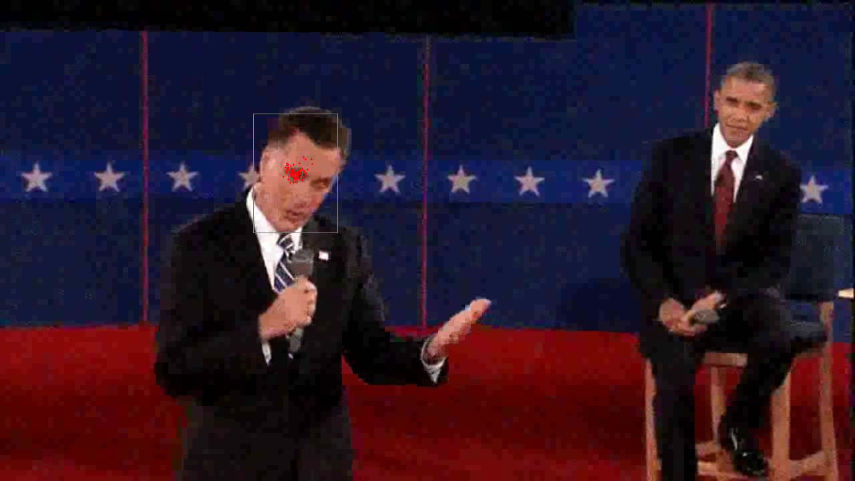
2b: PF Tracking noisy video (cont.)
ps5-2-b-2.png
Computer Vision @ GT

Slide 16
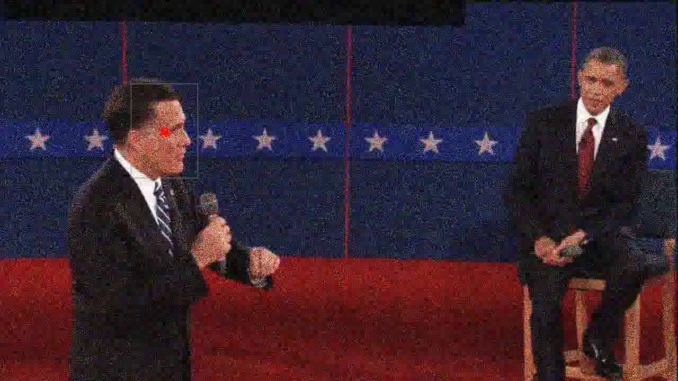
2b: PF Tracking noisy video (cont.)
ps5-2-b-3.png
Computer Vision @ GT

Slide 17
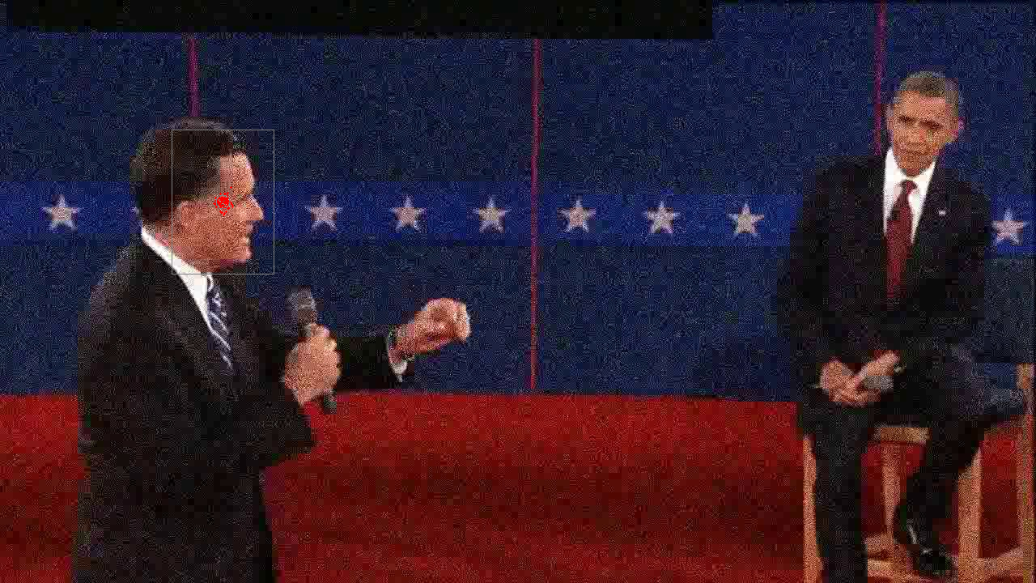
2b: PF Tracking noisy video (cont.)
ps5-2-b-4.png
Computer Vision @ GT

Slide 18
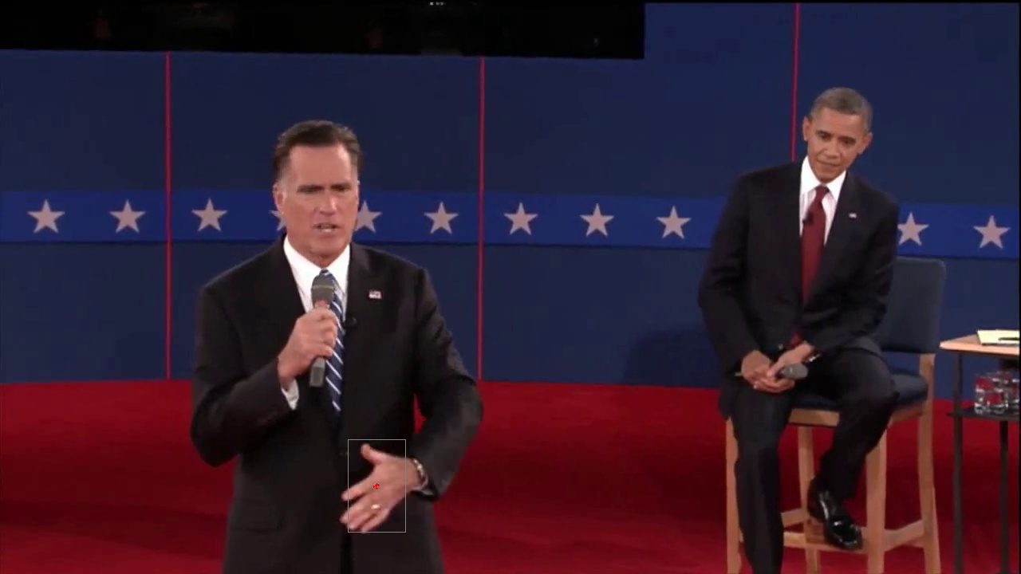
3a: PF Changes in Appearance
ps5-3-a-1.png
Computer Vision @ GT

Slide 19
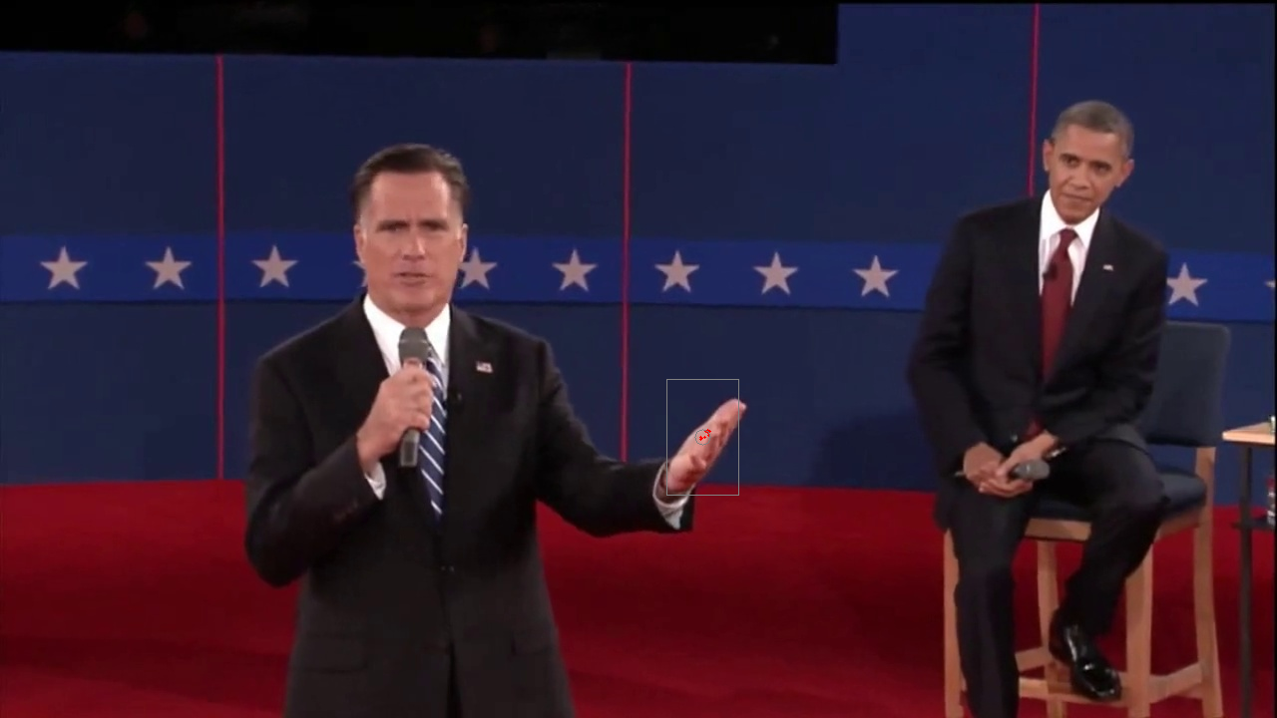
3a: PF Changes in Appearance (cont.)
ps5-3-a-2.png
Computer Vision @ GT

Slide 20
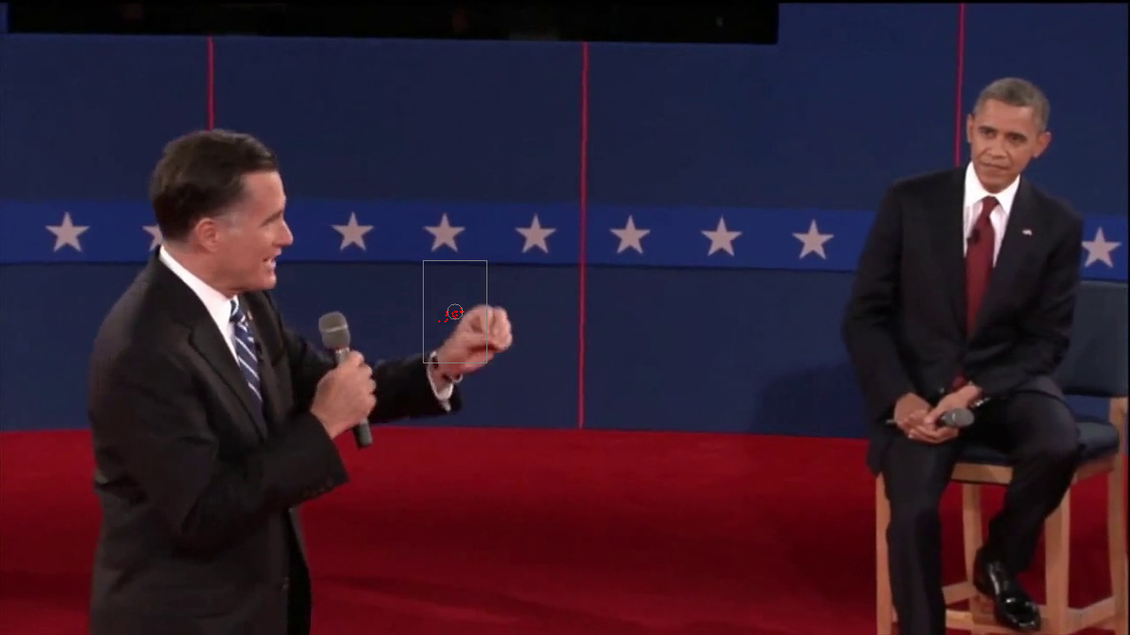
3a: PF Changes in Appearance (cont.)
ps5-3-a-3.png
Computer Vision @ GT

Slide 21
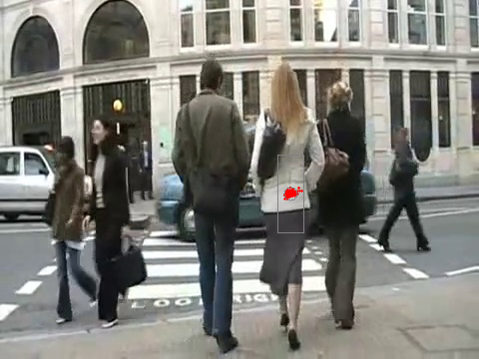
4a: PF Occlusions
ps5-4-a-1.png
Computer Vision @ GT

Slide 22
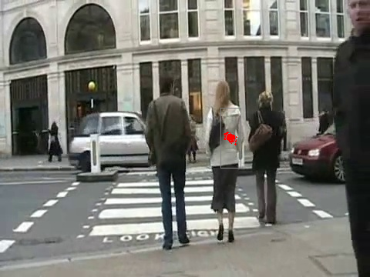
4a: PF Occlusions (cont.)
ps5-4-a-2.png
Computer Vision @ GT

Slide 23
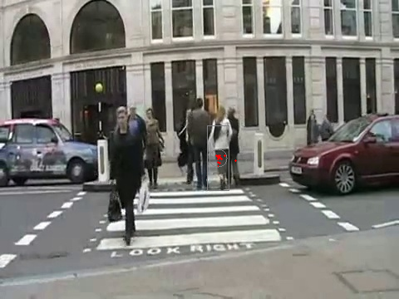
4a: PF Occlusions (cont.)
ps5-4-a-3.png
Computer Vision @ GT

Slide 24
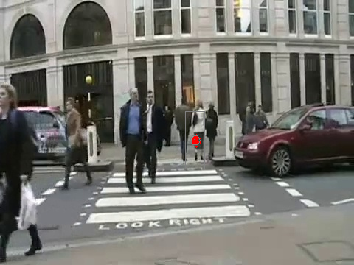
4a: PF Occlusions (cont.)
ps5-4-a-4.png
Computer Vision @ GT

Slide 25
4: Text response
To get this solution to work when dealing with occlusion and the scale of the template changing I made some strong underlying assumptions. Since I knew the lady was walking away from the camera, once the frame was done I would scale the template down by a tuning parameter. To assist with the scaling occurring too fast, I would limit it to only scale the image every n ( in my case 4) frames. I found this worked well in trying to keep track of the template size shrinking. Although it was not perfect, and at times would be too small, I was able to achieve desired results.
Another change that I made was to limit the move in location based on the MSE. If the MSE from the template was too high, I assumed that there was occlusion since we make the assumption that our templates do not move much from frame to frame. This allowed me to keep the previous location of the templates location if it was occluded and then resume searching from that spot the next frame. This allowed the template to remain tracking the woman crossing the street.
Computer Vision @ GT

Slide 26
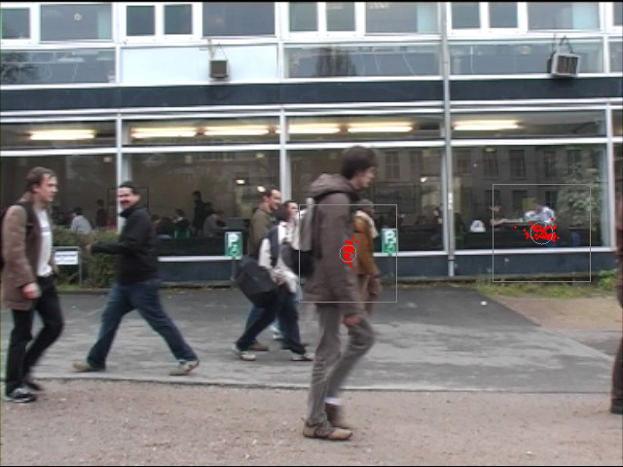
5: Tracking multiple targets
ps5-5-a-1.png
Computer Vision @ GT

Slide 27
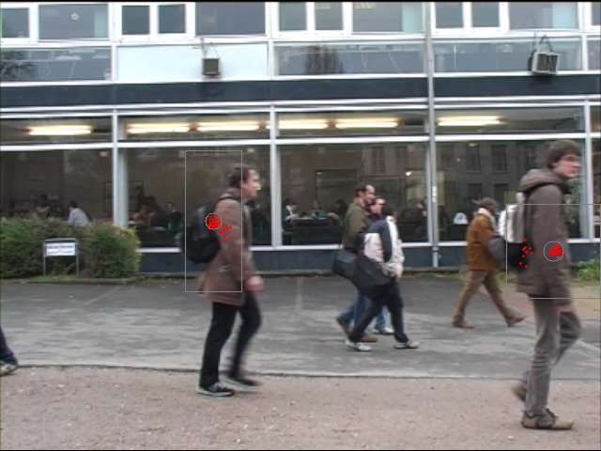
5: Tracking multiple targets (cont.)
ps5-5-a-2.png
Computer Vision @ GT

Slide 28
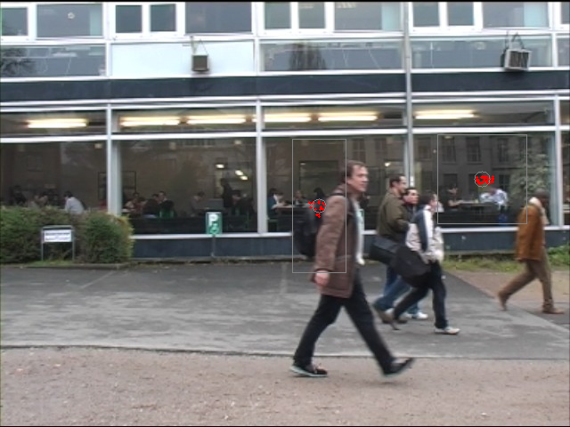
5: Tracking multiple targets (cont.)
ps5-5-a-3.png
Computer Vision @ GT

Slide 29
5: Text response
To get this problem to work, I first had to find and define the templates which I did by using Photoshop and manually analyzing the frames to determine when the respective person entered / left so I knew when I could start and stop processing each template.
I found that the KF performed poorly with multiple subjects so I decided to use the PF. No additional changes were made from the filter. It uses the same filter that was used for problem set 4, but the scaling of the template was set to 1 since there is no change in perspective of the templates, they are all remaining constant size.
To handle the multiple targets, I had to create 3 filters and run each on the frame before displaying the output.
Computer Vision @ GT

Slide 30

6: Challenge Problem
ps5-6-a-1.png
Computer Vision @ GT

Slide 31
6: Challenge Problem (cont.)
ps5-6-a-2.png
Computer Vision @ GT

Slide 32
6: Challenge Problem (cont.)
ps5-6-a-3.png
Computer Vision @ GT

Slide 33
6: Challenge Problem Text response
I did not complete the challenge problem due to time constraints. I attempted it to track the man, but had issues where the filters would not track him correctly. I tried to tune parameters with limited to no success.
Computer Vision @ GT

